Slide 1
Human Visual System
Last updated: 8-5-2023
$Szeliski R., Computer Vision, to be published by Springer, 2010. (Ch. 2)
Gonzalez R. C., Woods R. E., Eddins S. L., Digital Image Processing, Pearson Education, 3rd edition, 2007. (Ch. 2)
# For the graduate level course
@ For DIP students only
$ For CV students only
Dr. Zulfiqar Habib, Professor
http://vig.cuilahore.edu.pk
Notes:
www.csie.ntnu.edu.tw/~violet/IP93/Chapter06.ppt

Slide 2

Human Visual Limitations
Interesting Facts
جنات کا سائنسی تجزیہ
Notes:
https://www.facebook.com/booksbasement/posts/4067633049957522/

Slide 3

Human Visual Limitations
Notes:
https://youtu.be/WgwURd6ClpQ?si=oJT9v-E1cwFIdVdK

Slide 4
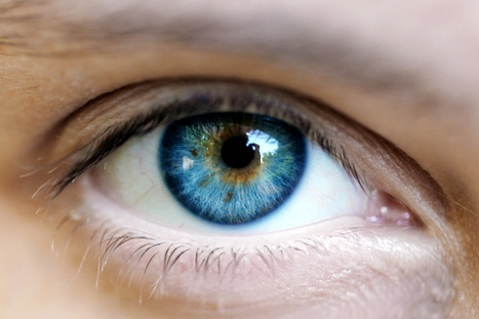
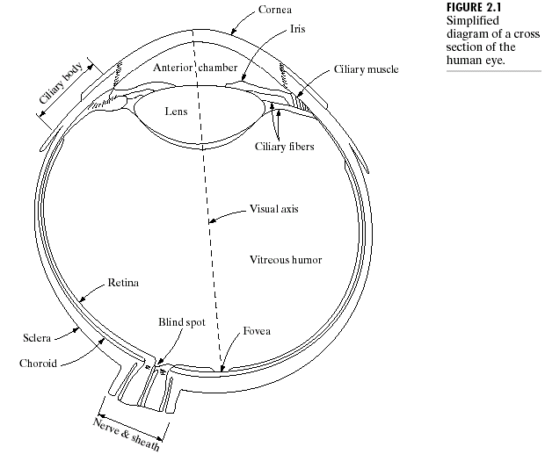

Elements of Visual Perception
Cornea
Sclera
Choroid
Retina
Iris
Lens
Macula lutea
Fovea
Blind spot
Rod
Cone
Watch from 2 min of frame
The human eye is a camera!
Notes:
https://youtu.be/8Are9dDbW24?si=FTn-GDf8Ta3rfWke

Slide 5
The Retina

Slide 6
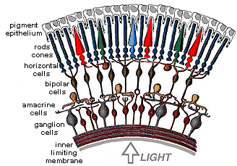
Retina Close-up
Notes:
Tapetum lucidum

Slide 7
Structure of the Human Eye
Pattern vision is afforded by the distribution of discrete light receptors over the surface of the retina.
There are two classes of receptors: cones and rods.
The number of cones in each eye: 6 to 7 millions
The number of rods in each eye: 75 to 150 millions
The cones are concentrated in the central portion of the retina (fovea).
The rods are distributed over the retinal surface.

Slide 8
Structure of the Human Eye
Photopic (bright-light) vision: vision with cones
Color receptors: highly sensitive to colors but less sensitive to light.
Each cone is connected to its own nerve end, therefore human can resolve fine details of colors.
High resolution in the fovea.
Color blind, lower resolution
Scotopic (dim-light) vision: vision with rods
Give a general overall picture of field of view, not involved in color vision
Much more sensitive to light (night vision)
Several rods are connected to a single nerve

Slide 9
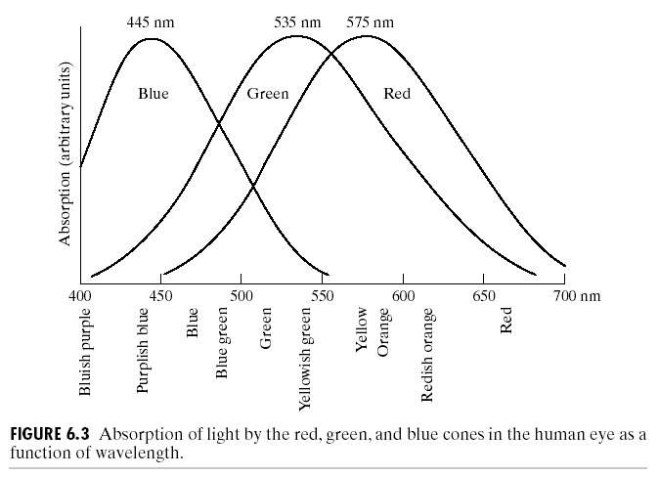
Structure of the Human Eye
Color is sensed by the eye using three kinds of cones, each sensitive primarily to red, green or blue, though there is significant overlap.
The International Commission on Illumination in 1931, referred to red, green and blue as the primary colors,
and denote to set as RGB:
blue = 435.8nm
green = 546.1nm
red = 700nm
Approximately:
65% cones are sensitive to red
33% cones are sensitive to green
2% cones are sensitive to blue
(but the blue cones are most sensitive)
Improved analysis in 1965

Slide 10
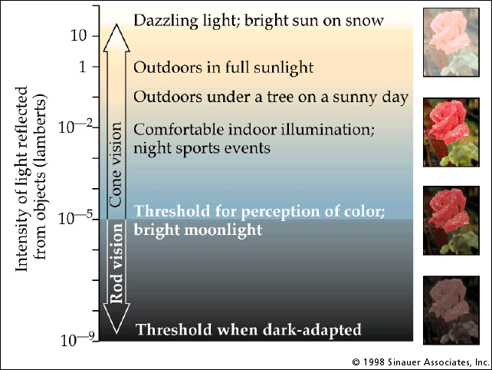
Structure of the Human Eye
Rod / Cone sensitivity

Slide 11
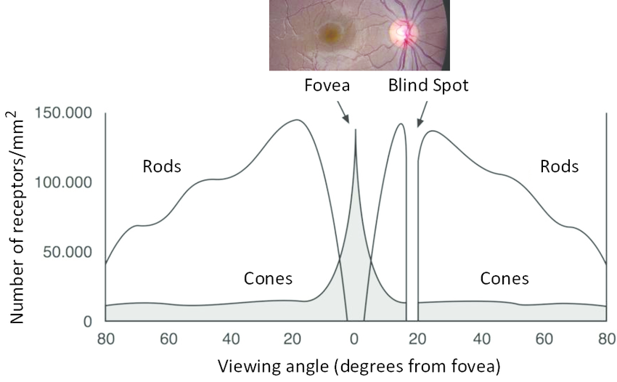
Structure of the Human Eye
Distribution of Rods and Cones

Slide 12
Structure of the Human Eye
Fovea can be viewed as a square sensor array of size 1.5 mm x 1.5 mm.
The density of cones in this square is approximately 150,000 elements per mm²
The number of cones in the region of highest acuity in the eye is about
1.5 x 1.5 x 150000 = 337,000 elements
CCD (charge-coupled-device) of medium resolution can have same density (150,000 elements per mm²), with size no more than 5mm x 5mm

Slide 13
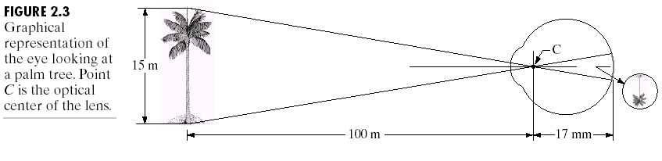
#Image Formation in the Eye
Focal length of the eye: 17 to 14 mm, depending on distance of object, above 3m (lowest refractive power) or below 3m (strongest refractive power), resp.
Let h be the height in mm of that object in the retinal image, then
15/100 = h / 17 , h = 2.55mm
The retinal image is reflected primarily in the area of the fovea.

Slide 14
Exercises
Why the objects appear brightly colored in day-light when seen by moonlight appear as colorless forms?
[1, P2.1] Estimate the diameter of the smallest printed dot that the eye can discern if the page on which the dot is printed is 0.2 m away from the eyes. (Ans. 0.0186 mm approx.)
Hint: We can think of the fovea as a square sensor array of 1.5mm x 1.5mm having on the order of 337,000 elements (cones), which translates into an array of size 580x580 elements. Assuming equal spacing between elements, this gives 580 elements and 579 spaces on a line 1.5 mm long, making diameter of cone 1.5/(580+579) mm.
Notes:
2.1, 2.2, 2.5

Slide 15
Exercises
[1, P2.2] When you enter a dark theater on a bright day, it takes an appreciable interval of time before you can see well enough to find an empty seat. Which of the visual process is at play in this situation?
[1, P2.5] A CCD camera chip of dimensions 7 x 7 mm, and having 1024x1024 elements, is focused on a square, flat area, located 0.5 m away. How many line pairs per mm will this camera be able to resolve? The camera is equipped with a 35-mm lens. (Ans. 5 line pairs per mm)
Notes:
2.1, 2.2, 2.5

Slide 16
References
Gonzalez R. C., Woods R. E., Digital Image Processing, Pearson Education, 2006.
Szeliski R., Computer Vision, Springer, 2011.
http://www.imageprocessingplace.com/

